Slide 1
ინდუსტრიის საგანმანათლებლო პროცესში ჩართვის გზები
მაგდა ცინცაძე, პროფესორი, თსუ
Magda Tsintsadze, Professor, TSU
Notes:
It is my distinct pleasure to welcome you all to the Ways of Involving the Industry in the Education Process workshop, here at Tbilisi State University. We are gathered today with a shared purpose: to explore and strengthen the critical relationship between industry and education.
The primary goal of this workshop is to foster a deeper understanding of how we can bridge the gap between academia and industry to benefit our students, educational institutions, and society as a whole. We aim to examine how collaborative efforts can reshape curricula, influence pedagogical approaches, and drive forward innovation in both educational and professional landscapes.

Slide 2
Content
Brief introduction to the event and participants
Highlight the importance of the gathering
Acknowledge key speakers and industry partners

Slide 3
Workshop Goals and Objectives
Identify successful industry-academia collaboration models
Explore strategies for integrating industry into education
Establish long-term partnerships for innovation and growth
Notes:
Our discussions today will focus on three central objectives:
To identify successful models of collaboration between universities and industries that are already yielding tangible results, in the form of curriculum enhancements, student employability, and knowledge transfer.
To explore practical strategies for integrating industry involvement into educational programs, ensuring that the skills students acquire align closely with the rapidly changing demands of the workforce.
To lay the groundwork for long-term partnerships, facilitating ongoing dialogue and joint initiatives that drive innovation and economic growth while also preparing the next generation of leaders and thinkers.
Through panel discussions, presentations, and networking opportunities, we hope to emerge with actionable ideas that we can implement within our own institutions and organizations.

Slide 4
Why Industry Involvement Matters
Academic knowledge and real-world practice
Benefits to Students
Industries drive technological and economic change
Education needs to stay current with industry demands
Benefits for students, universities, and industries
Real-world experience through internships and projects
Industry-relevant skills make graduates job-ready
Exposure to innovation and problem-solving
Benefits to Universities
Curriculum tailored to current industry needs
Enhanced research opportunities
Stronger reputation through successful student outcomes
Notes:
The gap between academic knowledge and real-world practice can be closed when industries are deeply involved in shaping education
Industry engagement provides students with hands-on learning that bridges the gap between theory and practice.
By aligning with industry, universities can ensure their programs remain relevant and responsive to future trends.
For students, it means more relevant, hands-on learning experiences that translate directly into employability. It ensures they are not just academically prepared but also ready to hit the ground running when they enter the workforce.For universities, it provides valuable insights into industry standards, allowing us to evolve our curricula to meet the practical needs of employers.

Slide 5
Benefits to Industry
Access to a skilled, prepared workforce.
Opportunities to collaborate on cutting-edge research.
Contributions to shaping future innovators and leaders
Notes:
Industries are increasingly recognizing the value of engaging with academia—not only to ensure that graduates possess the skills and knowledge necessary to thrive in the workplace, but also to fuel innovation. By working together, we can design programs that respond to the latest industry trends, anticipate future needs, and ensure that students are equipped with both technical expertise and the critical soft skills required in today’s global market.
Industries gain from partnerships with universities by securing a pipeline of talent and innovation

Slide 6
Engaging with Industry
Call to Action
Open dialogue between academia and industry is essential
Encourage active participation in discussions
Seek partnerships and practical outcomes
Success stories in industry-academia collaboration
Strategies to align curriculum with workforce needs
Enhancing student employability through internships and joint projects
Notes:
Now more than ever, the world is moving at a remarkable pace, driven by technological advancements, global competition, and shifts in how we work and live. The traditional model of education, where students learn in isolation from real-world industry challenges, is no longer sufficient. I encourage all of you to share your insights, explore opportunities for collaboration, and help shape the future of education together.

Slide 7
Call to Action
Encourage active participation in discussions
Enhancing student employability through internships and joint projects
Open dialogue between academia and industry is essential
Align curriculum with workforce needs
Notes:
Our workshop today is designed to explore these synergies and identify how we can embed industry participation into the very fabric of education, from curriculum design to experiential learning opportunities like internships, joint research projects, and more.
As we proceed through today’s sessions, I encourage you to engage actively, share your insights, and consider how we can turn these discussions into lasting collaborations that truly benefit all stakeholders—academia, industry, and above all, our students.

Slide 8
Speakers and Moderator
Prof. Mahasweta Sarkar
Prof. Juergen Znotka
Prof. Nazim Agoulmine
Prof. Magda Tsintsadze
SDSU, USA
WH, Germany
Evry, France
TSU, Georgia

Slide 9
Industry Representatives and Moderator
Temo Magradze
Ketevan Dolakidze
Rezo Lomtatidze
Nato Chubinidze
Ina Egieva
Prof. Manana Khachidze
SWEEFT
Quantori
SOLVIT
TSU
DataART
TSU

Slide 10
Creating an Industrial Advisory Board
TSU’s Experience – Building Industry Partnerships
Personal experience establishing an Industrial Advisory Board
Introducing Committees for International ABET Accreditation
Outcomes of industry involvement in shaping curricula at TSU
TSU partnered with industry leaders to form a board that provides continuous feedback on course content, emerging trends, and workforce needs.
The board meets regularly to discuss curriculum updates, industry challenges, and opportunities for student engagement.
Notes:
At TSU, we have firsthand experience in forging strong ties with industry. A few years ago, we recognized that for our programs to stay competitive and globally recognized, we needed to invite industry leaders to the table. This led to the establishment of our Industrial Advisory Board, where companies like [Company Names] began playing an active role in shaping our curricula
Our Industrial Advisory Board helped us align our programs with the needs of the labor market. Industry representatives provided crucial insights on skills gaps and technology trends, allowing us to adapt our curricula. For example, our software engineering programs now emphasize emerging technologies like AI and cybersecurity, areas that industry identified as high-demand

Slide 11
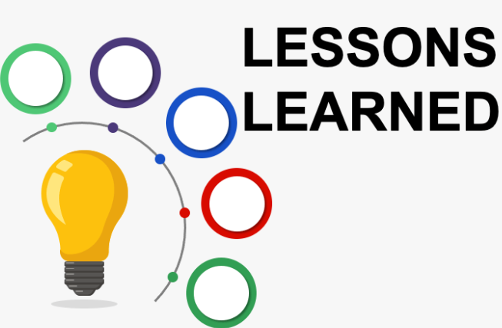
Continuous feedback loop: Industry involvement must be ongoing to keep curricula relevant.
Lessons Learned and Benefits
Benefits of industry collaboration: Enhanced student employability, curriculum relevance, and global recognition.
Challenges overcome: Coordinating between academia and industry needs, aligning curriculum changes with accreditation requirements.
Long-term impact: Industry’s sustained involvement ensures that TSU continues to adapt its programs to future workforce needs
Key Takeaways from TSU’s Experience
Collaborative effort: Success requires buy-in from both academia and industry
Continuous feedback loop: Industry involvement must be ongoing to keep curricula relevant.
Accreditation as a driver: International standards like ABET can help structure industry engagement and ensure global competitiveness.
Notes:
One of the greatest lessons from our experience was the need for continuous, open dialogue between academia and industry. The involvement of industry experts not only contributed to our ABET accreditation but also ensured that our students were ready to enter a rapidly changing workforce By creating formal partnerships with industry and introducing committees for accreditation, we’ve been able to build programs that not only meet international standards but also produce graduates who are truly workforce-ready

Slide 12
Thank You!
Notes:
The challenge before us is significant but exciting. Through deeper industry involvement, we have the power to transform education in ways that can make a real difference in the lives of students and the success of our industries. Let’s make today a turning point in our ongoing efforts to build a more responsive, future-oriented educational system.
Thank you all for being here, and I look forward to a productive day of collaboration, ideas, and innovation.

