Slide 1
Bridging the skill gaps : Industry input on curriculum design
University Perspective

Slide 2
My perspective and how does it matter?
Faculty in Computer Engineering for 18 years
Research Area – Wireless Networks,
AI in Wireless, Wireless in several applications
Graduate Advisor for 4 years
Admission decisions on Masters and Ph.D. students
Academic advising for these students
Senior Associate Dean
Working on engaging international learners in our degree programs
Student needs and asks:
What courses can I take?
What are the job prospects?
Courses – Jobs
Academia – Industry

Slide 3
Introduction
Importance of collaboration between universities and industries
Addressing the skill gaps in the workforce
The impact of evolving market needs

Slide 4
The Challenges We Face
Disconnect between academic training and industry requirements.
85 million jobs worldwide could go unfilled due to skill gaps.
Need for graduates equipped with both technical and soft skills.

Slide 5
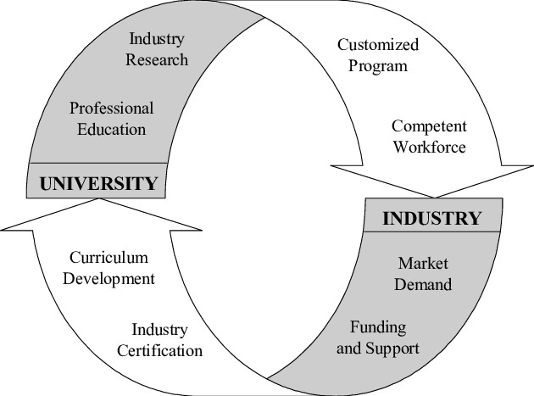
Understanding Industry Needs
Key Areas of Demand:
Technical Skills: data analytics, AI, cybersecurity
Soft Skills: communication, teamwork, adaptability
Hands-on Experience: internships, co-ops, project-based learning, digital badging

Slide 6
Collaborative Curriculum Design
Engage
Engage Industry Stakeholders: Form advisory boards
Develop
Develop Dynamic Programs: Regular updates and feedback
Incorporate
Incorporate Real-World Projects: Apply learning to real scenarios (Senior Design)
Foster
Foster Interdisciplinary Learning: Combine knowledge across disciplines

Slide 7
The Role of Continuous Learning
Prepare
Prepare students for lifelong learning and adaptability
Provide
Provide alumni access to ongoing education and networking
Encourage
Encourage a mindset of continuous improvement

Slide 8
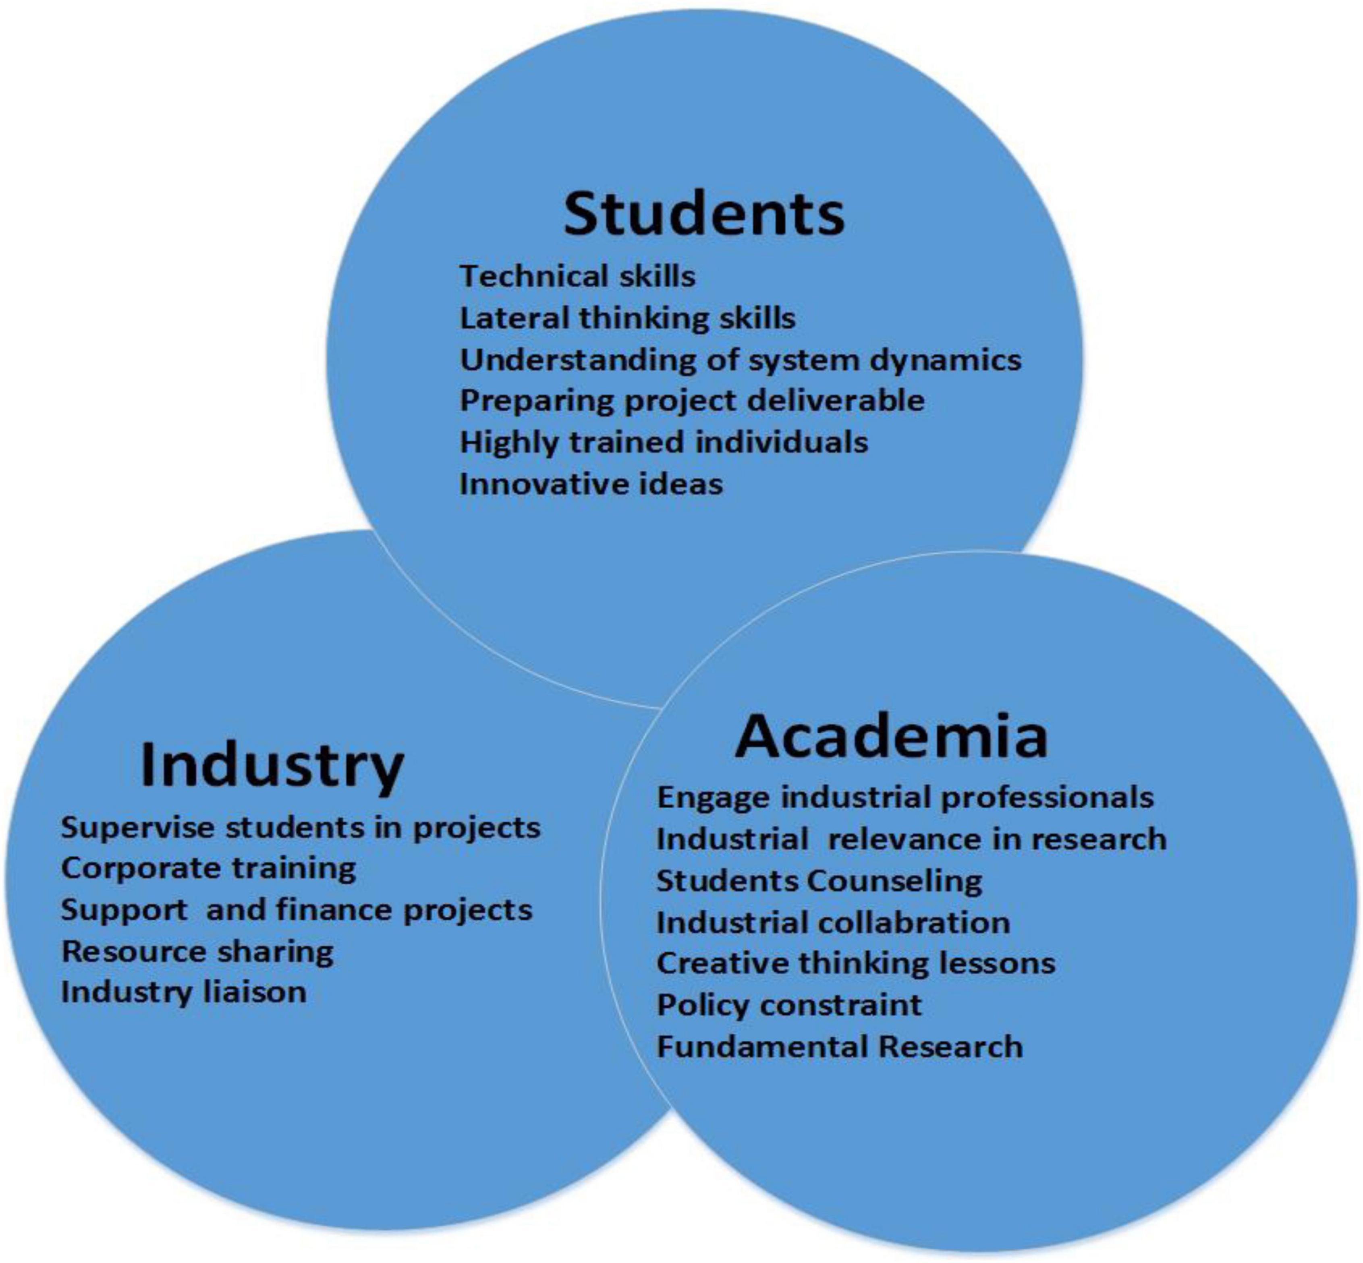
Conclusion
Shared responsibility to bridge skill gaps.
Importance of communication and collaboration.
Equip graduates to lead and innovate in future industries.

Slide 9
Questions

